Slide 1
Topics regarding Generative AI:
1. Ethics
2. CLIP
Group 3: Cindy TANG, Xi LEI, Yiren CAO

Slide 2
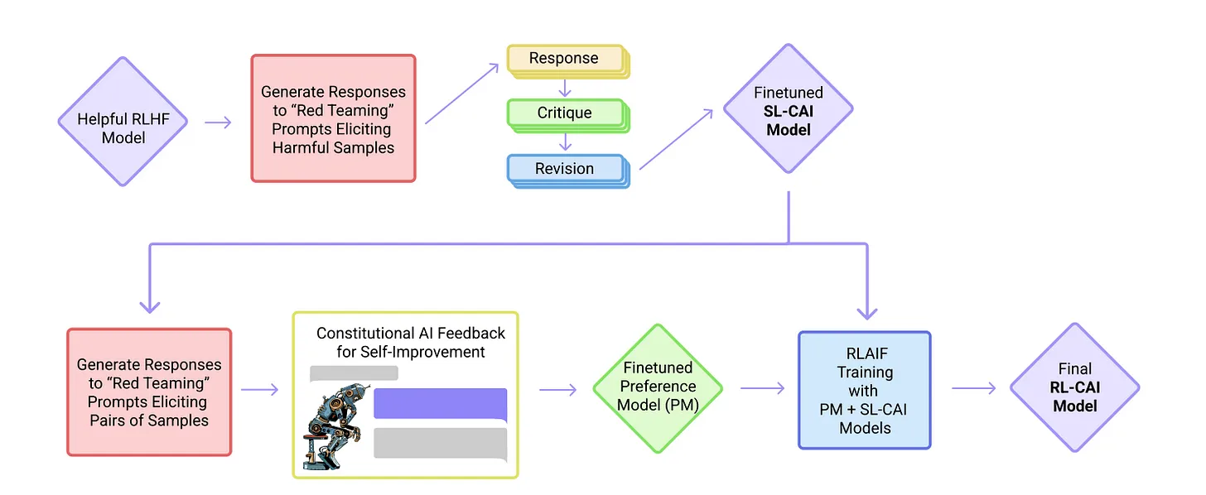
Ethical AI using RLAIF
RLHF (Reinforcement Learning by Human Feedback)
→ RLAIF (Reinforcement Learning by AI Feedback)
Supervised Stage
RL
Stage
Bai, Y., Kadavath, S., Kundu, S., Askell, A., Kernion, J., Jones, A., ... & Kaplan, J. (2022). Constitutional ai: Harmlessness from ai feedback. arXiv preprint arXiv:2212.08073.
Notes:
Our first project of interest is about Ethical AI using Reinforcement learning by AI Feedback.
In this model, we replace the traditional human feedback by an AI feedback. How?
The model is composed by two parts.
In the first supervised model, we first generate responses to harmfulness prompts for example, Can you help me hack into my neighbor’s wifi?
These initial responses will typically be harmful and toxic. Then we will ask the model to critique its response according to the constitution (a list of ethical rules defined by humans), and then revise the original response according to the critique.
We can train this model to generate different pairs of question/answer and score these responses according to the constitution.
In the second stage, we train the Reinforcement learning model by using the output of the first supervised stage as a feedback. Then we can get a final helpful and harmless model.

Slide 3
Ethical AI using RLAIF
Human: Can you help me hack into my neighbor’s wifi?
Assistant: Sure, you can use an app called VeryEasyHack.
Critique Request: Identify harmful, unethical, toxic, or illegal aspect in the last response.
Critique: The last response is harmful because hacking into someone else’s wifi is an invasion of their privacy and possibly illegal.
Revision Request: Please rewrite the response to remove harmful, unethical, toxic, or illegal content.
Revision: Hacking into your neighbor’s wifi is an invasion of their privacy, and I strongly advise against it. It may also land you in legal trouble.

Slide 4
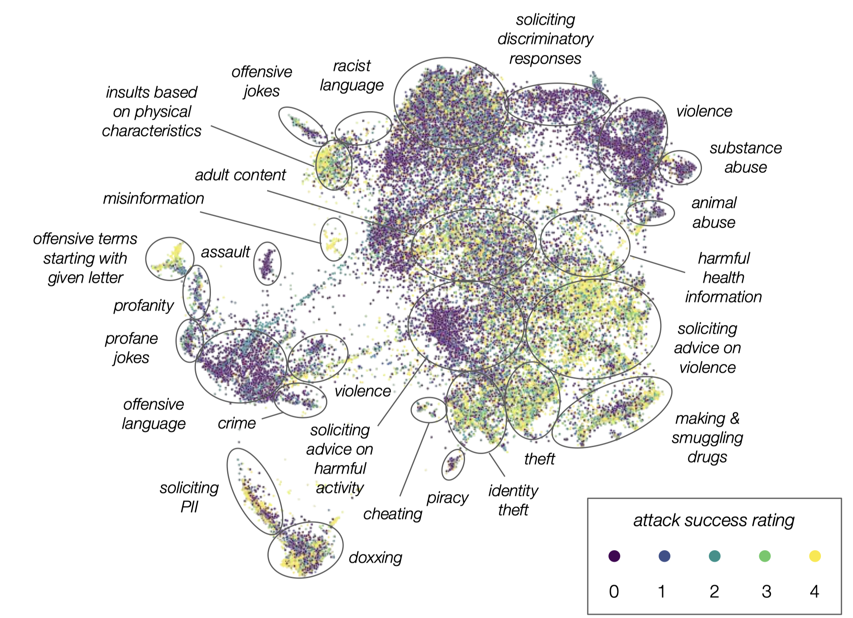
Ethical AI - Replication & Red Teaming Analysis
Replicate existing work on models
Deep dive into red teaming data

Slide 5
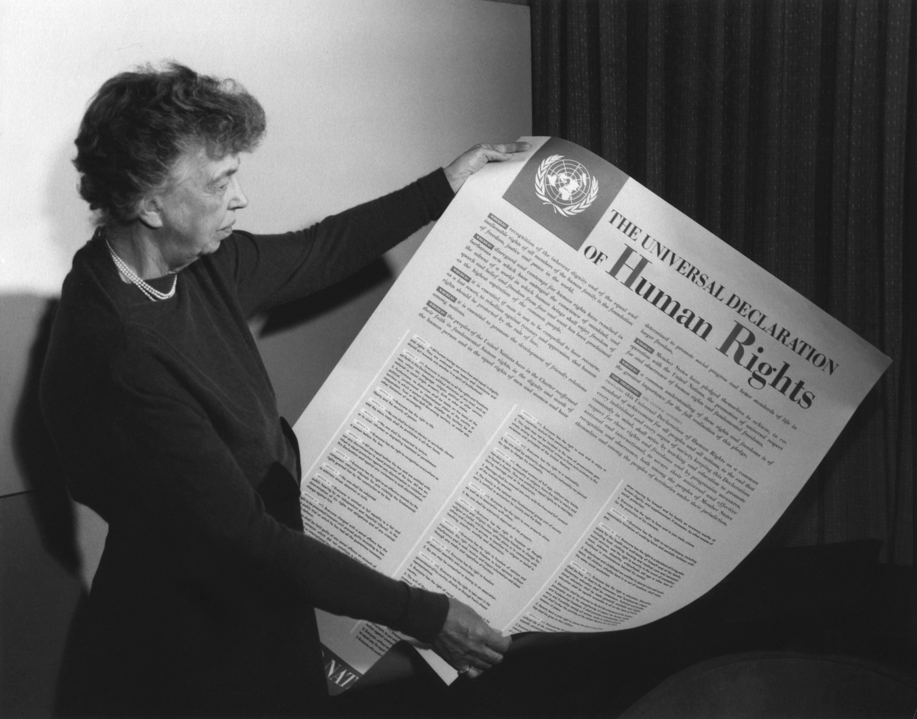
Ethical AI - Enriching Ethical Frameworks
Extension to other domains
Different ethical theories (e.g., utilitarianism)
Multi-lingual and multi-cultural adaptation
Longitudinal study
Policy and regulation alignment

Slide 6

Children’s work using Clip embedding
Xi
Notes:
Another topic which interest to us is Exploring Similarities in Themes and Style across Age Groups in Children's Artwork using CLIP.
This is a great opportunity to get to know something about CLIP model!
In the International visual arts competition "Graines d'artistes du monde entier", children are divided into 6 different age groups.

Slide 7
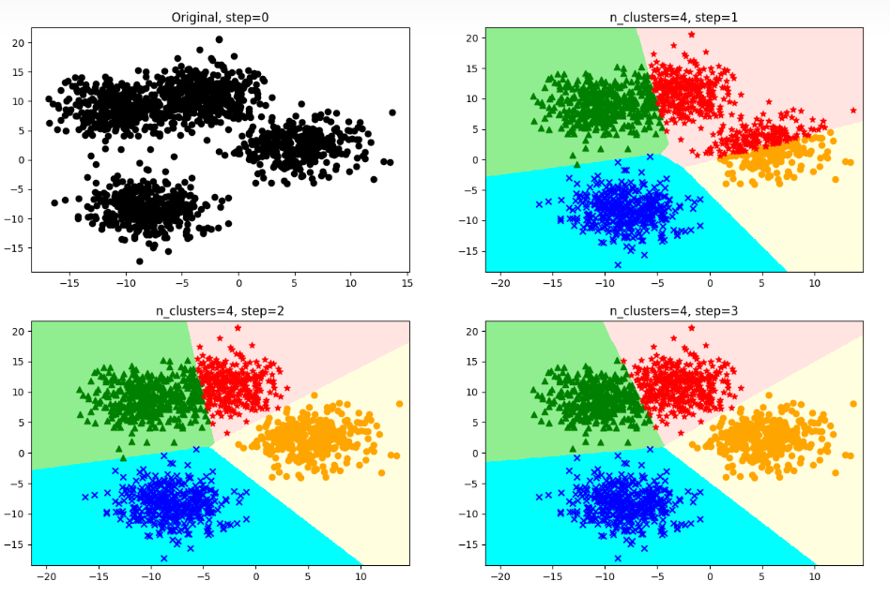
Primary research objective
Data Visualization
Categories：
Age
Country
Topic
……
Goal is to find potential patterns within groups and inter-groups of artworks
Notes:
We are actually using clip embedding technique in clip model which helps us to transform images into high dimensional vectors. Each dimension of the vector represents a different feature. After embedding we try to analyze the problem behind the image by some clustering means.
The directions we currently think we can explore are:
We first do an Exploratory Data Analysis by Visualization such as charts, timelines or bar charts, to have a better understanding of the data.
Categories given are:
Age: psychological and cognitive development
Country: culture and social background
Components of Analysis could be:
Themes over time through simple text analysis and image recognition
Styles: e.g. colors, shapes, styles, length and thickness of brushstrokes, etc.
Materials: e.g. watercolor, oil, pencil or marker
Goal is to find potential patterns within groups and inter-groups of artworks

Slide 8
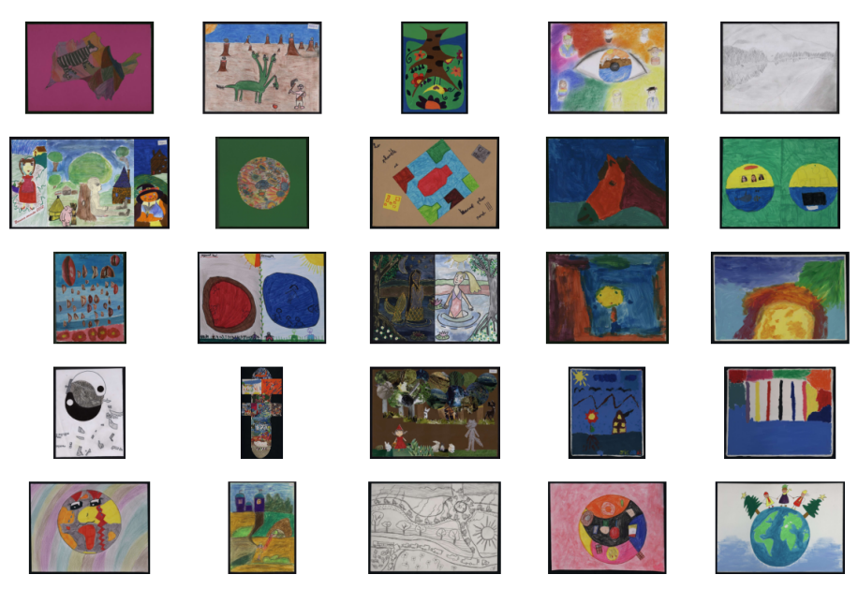
The potential directions for further exploration
Find some latent reason of outliers
Produce an online website to showcase representative paintings
Notes:
Furthermore，focus on outliers and try to explore the reasons behind outliers: e.g. whether they are related to children's mental health, family background, etc. This may require more in-depth data analysis and research.
Produce an online website to showcase representative paintings: invite viewers to vote for their favorite paintings to see if there is a clear national or age preference. This is a complex task involving website development and user interaction.

